Slide 1
Covina High School
Common Application/Naviance
Information Workshop

Slide 2
What you need before you apply
Transcripts –
You will need to refer to them as you fill out the application to ensure the information you enter is accurate.
You will need the counselor or registrar to officially submit transcripts through naviance.

Slide 3
What you need before you apply
Test scores –
You’ll have to include your scores from the ACT Plus Writing and/or the SAT.
Most colleges will only accept the October, November & December SAT & ACT dates from your senior year.
Remember to report all SAT Subject Tests or Advanced Placement exams you have taken.

Slide 4
What you need while applying
Social Security number, if you have one-
This is used to match your application to your test score report, final transcript, and your Free Application for Federal Student Aid.
California Statewide Student ID –
Each K-12 student in California public schools is assigned an ID number. It is printed on the bottom left of the transcript.
Credit Card –
You will need this to pay the application fee prior to submitting the application.

Slide 5
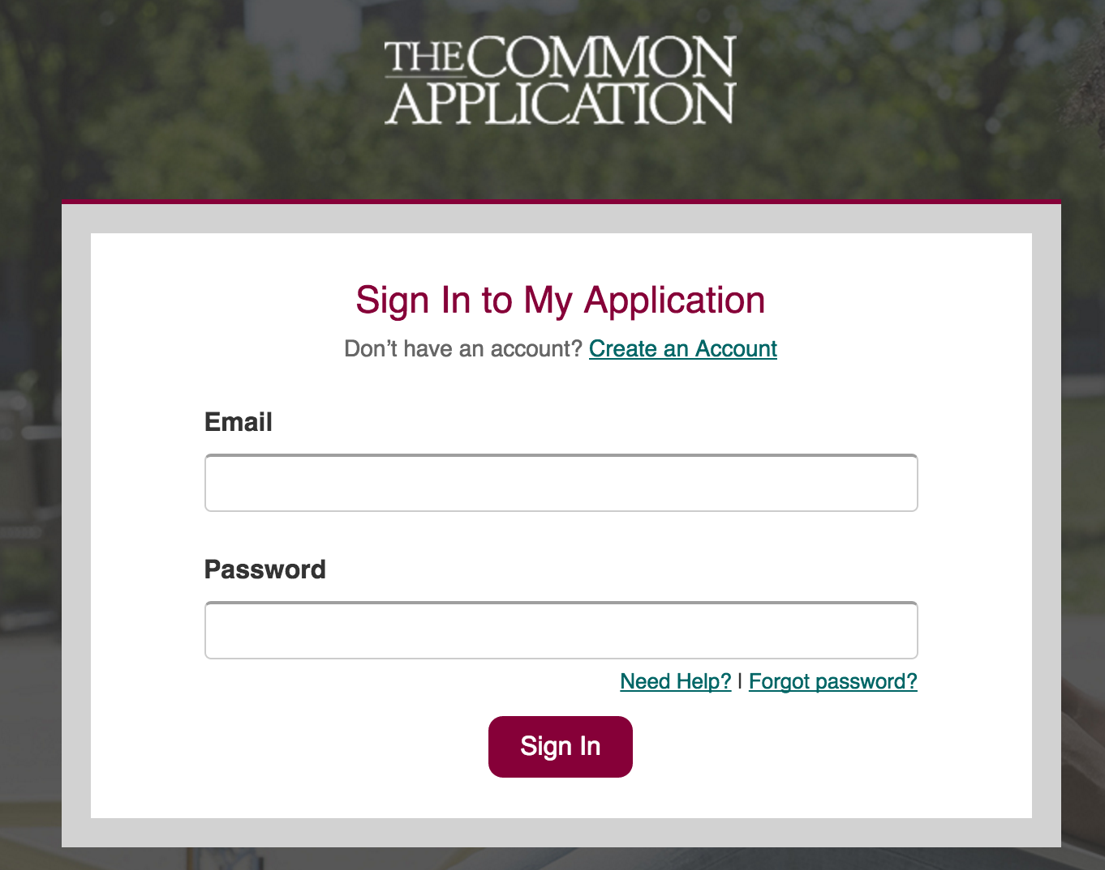
The Common Application www.commonapp.org
Start Here
Find colleges that accept the Common App
Create an account

Slide 6
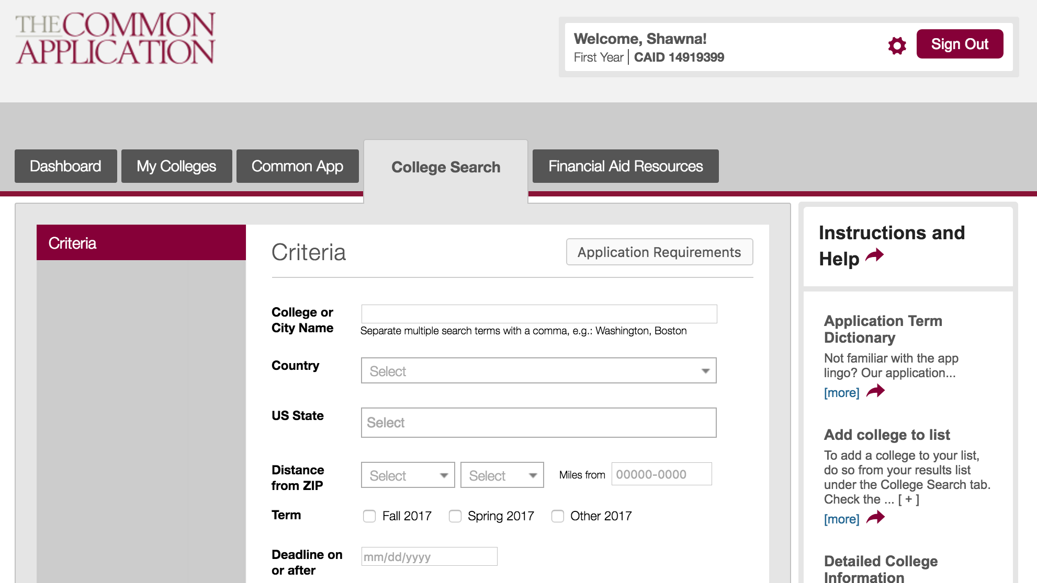
College Search
Help center on every page
Select College(s)

Slide 7
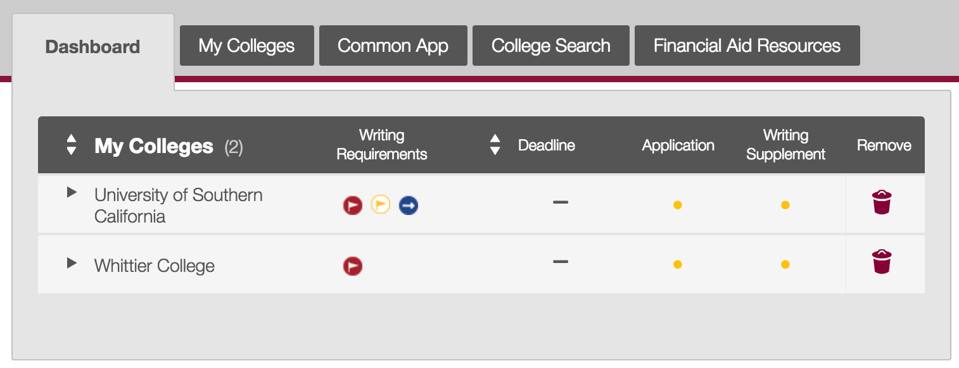
Dashboard
Dashboard will list all college(s) you are planning to apply to

Slide 8
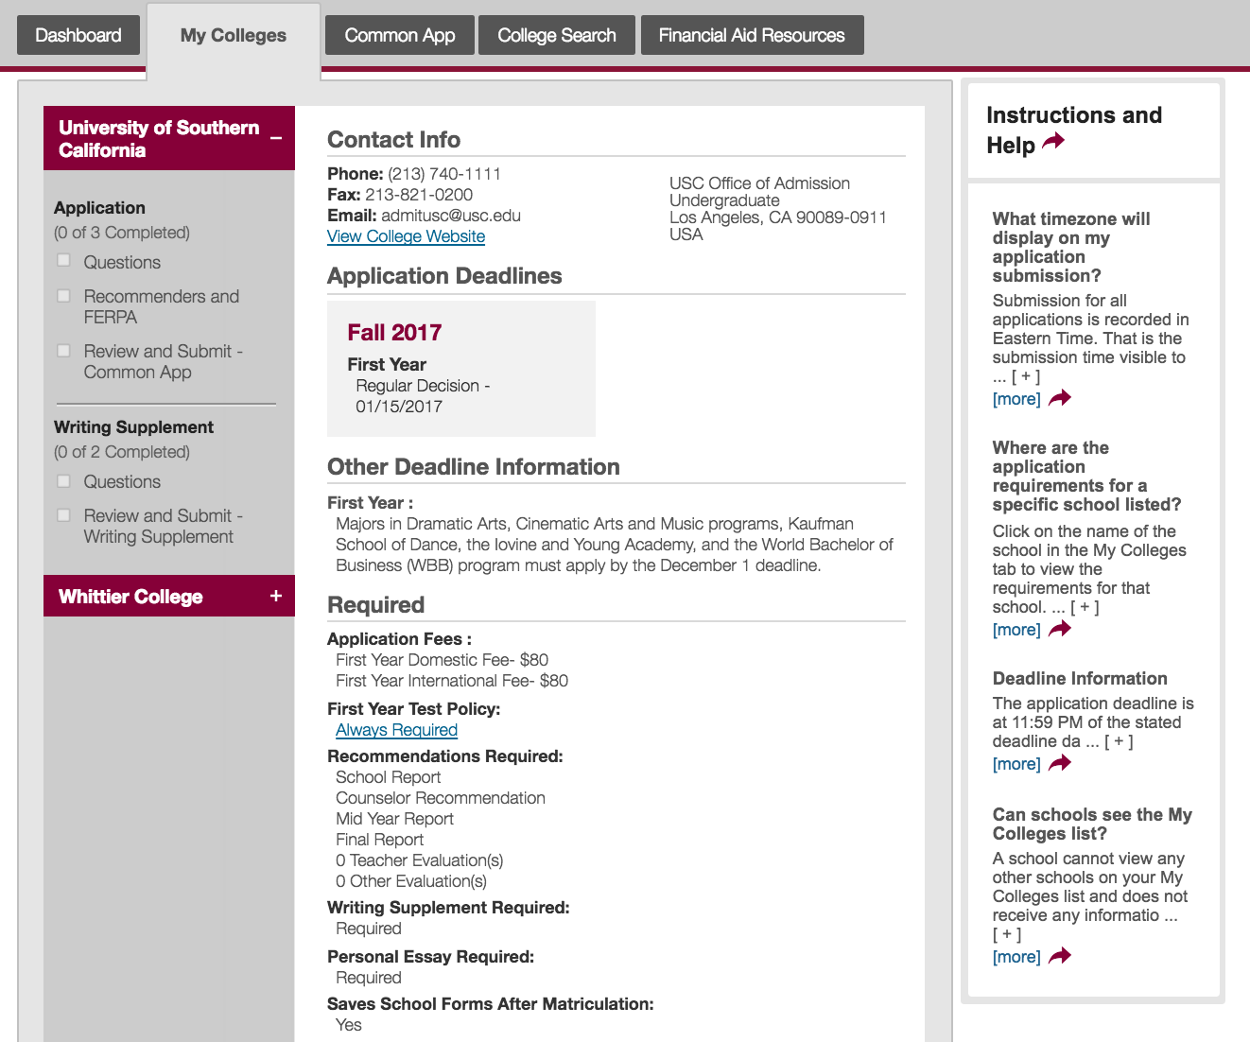
My Colleges
Specific college requirements

Slide 9
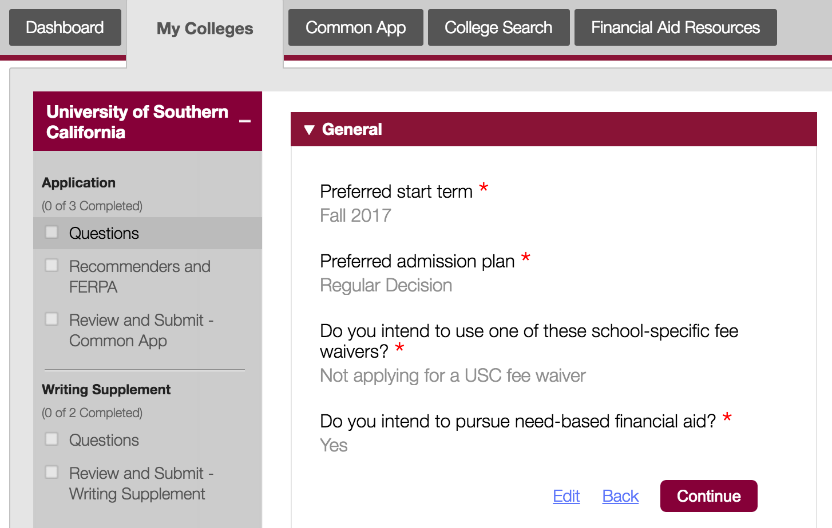
My Colleges

Slide 10
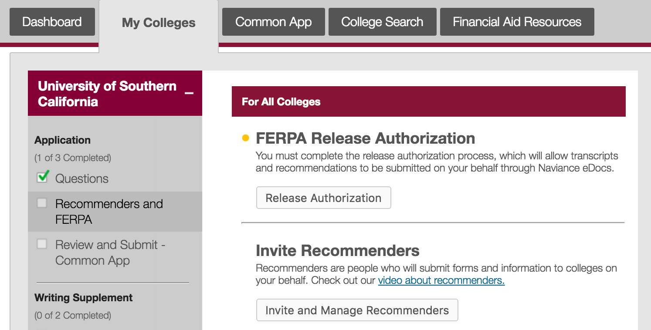
My Colleges
In order for your application to be complete, you must complete the FERPA Release Authorization prior to linking your account to Naviance.

Slide 11
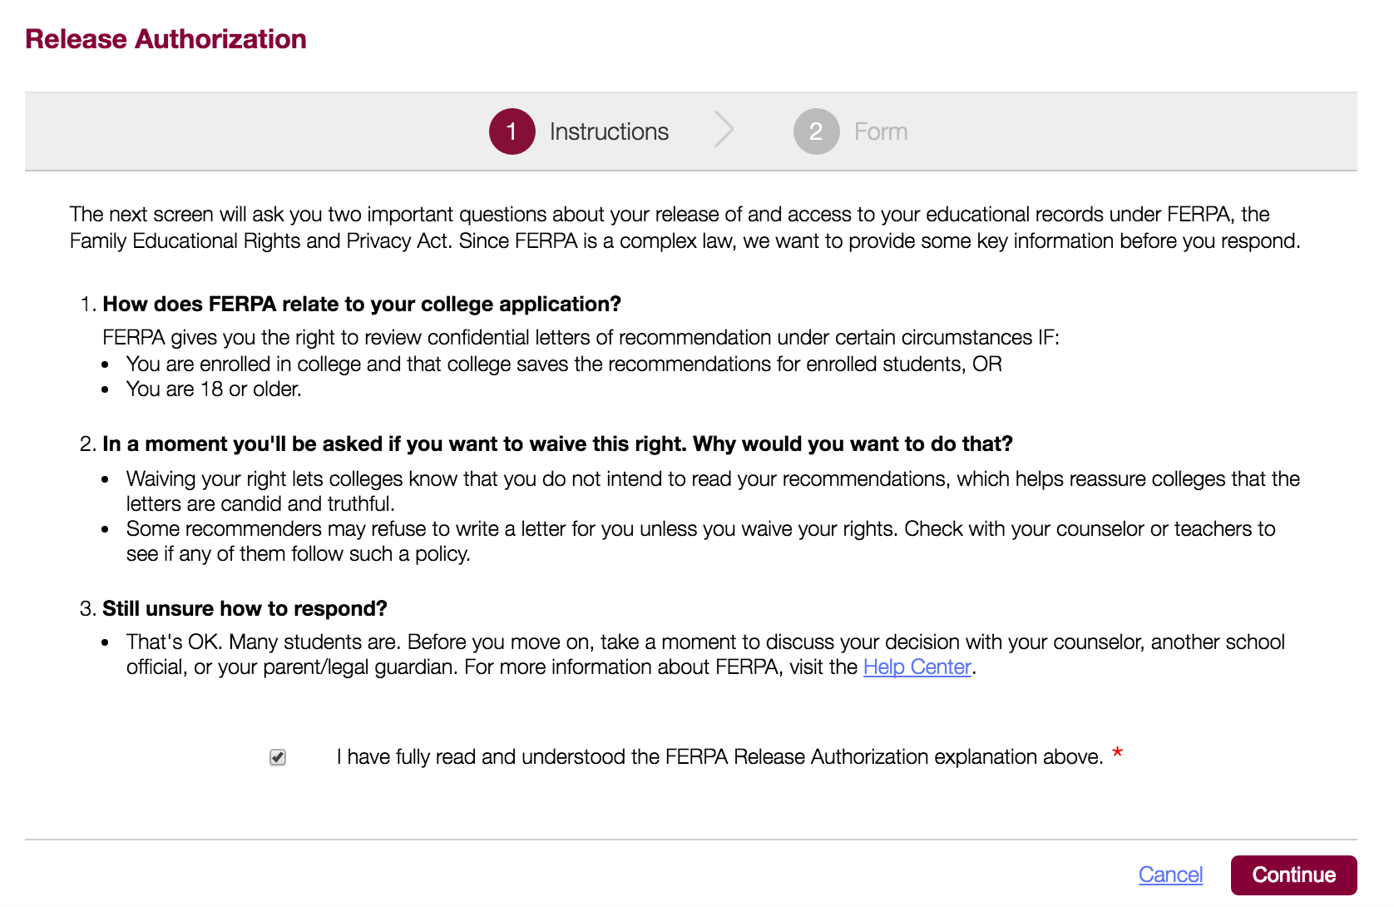
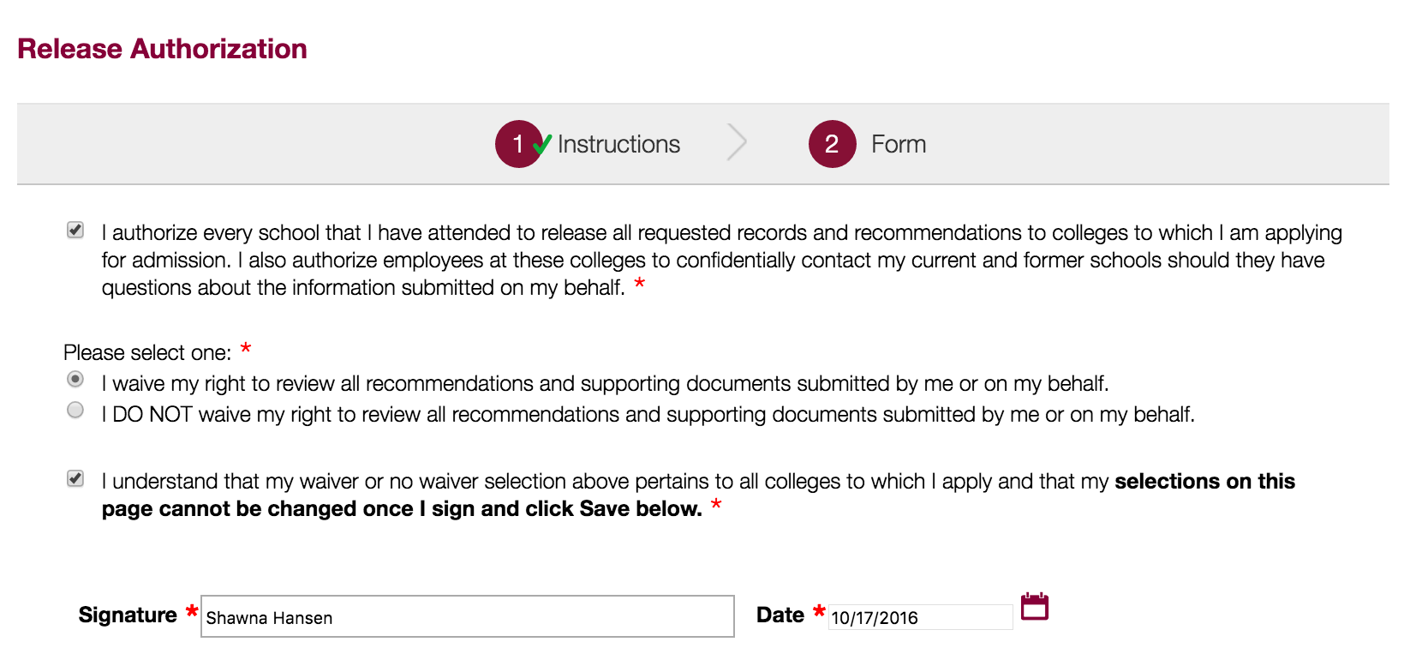
My Colleges

Slide 12
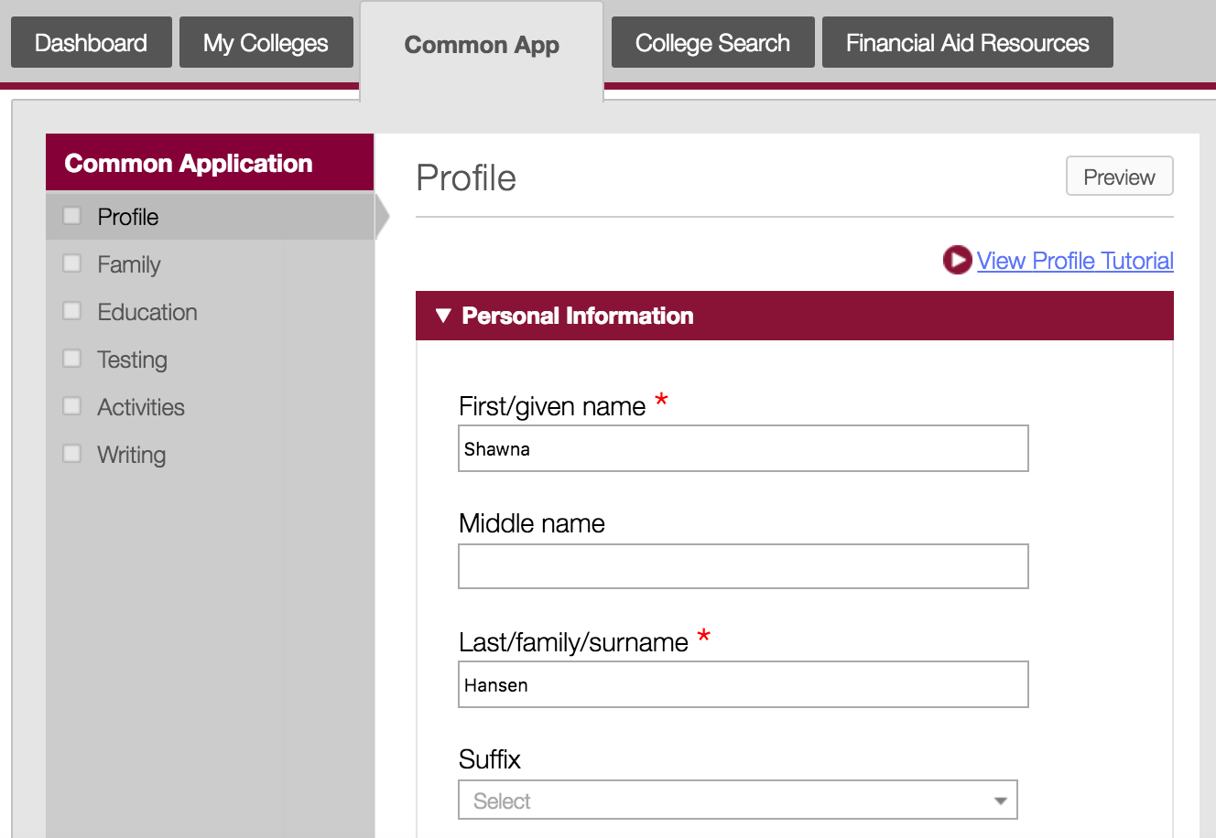
Common App Tab
Complete all personal information

Slide 13
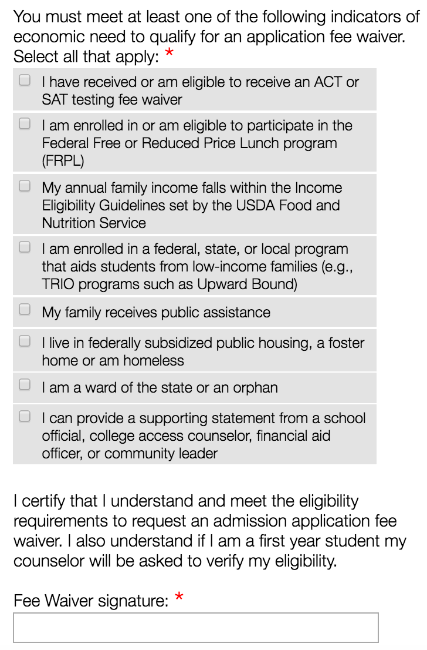
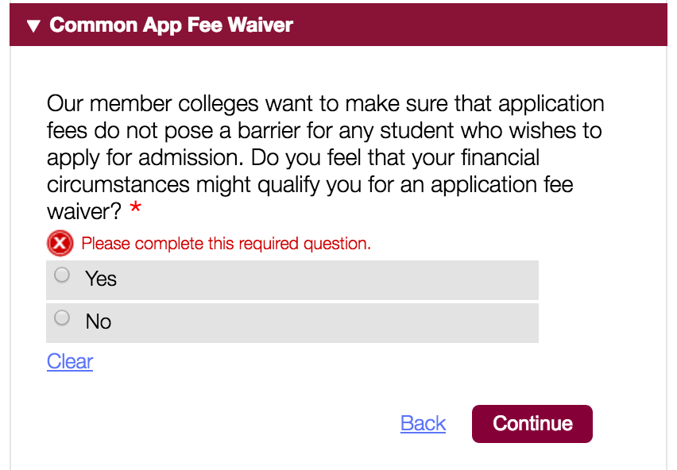
Fee Waiver
Check yes if you think you might qualify because you receive free or reduced lunch. Your counselor will verify as part of the school report.

Slide 14
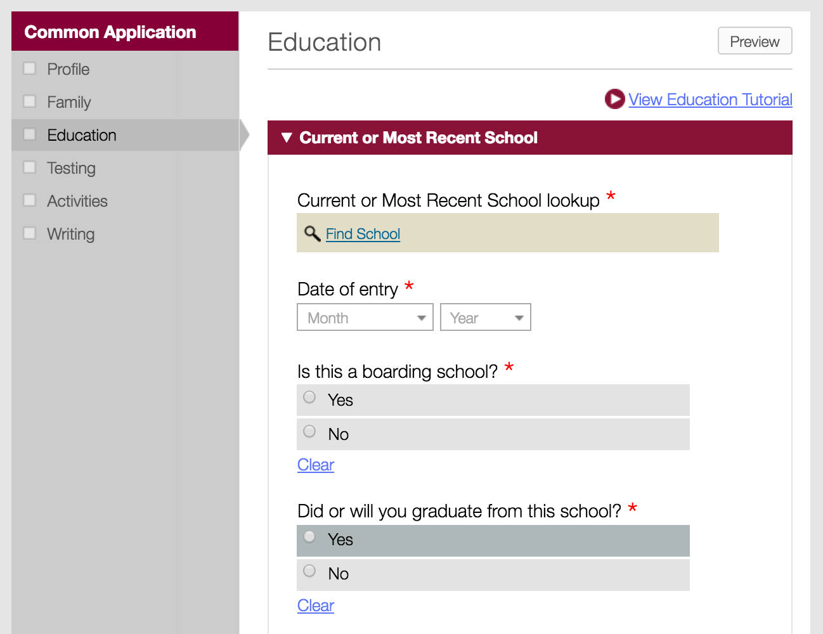
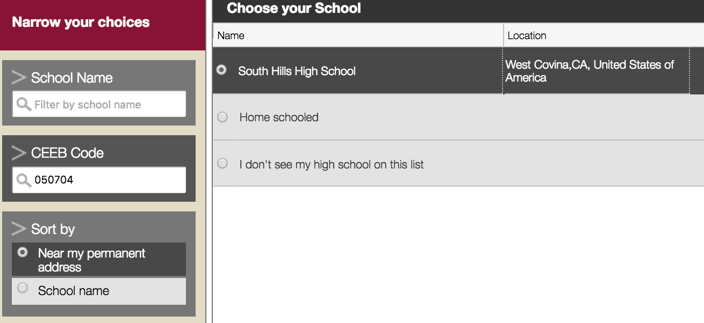
Education
School Code: 050700
Date of Entry: 8/2014
Graduation Date: 6/2018

Slide 15
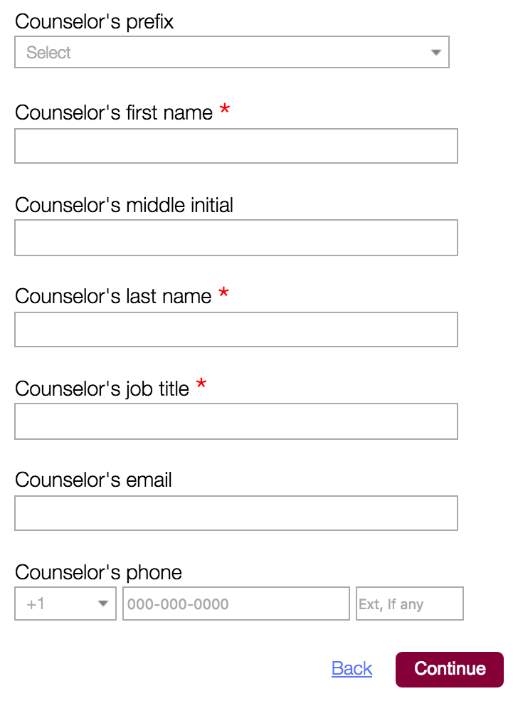
Education
Counselor Info:
Mrs. Erin Lippert
Counselor
elippert@c-vusd.org
626-974-6107
Mrs. Wendy Travis
Counselor
wtravis@c-vusd.org
626-974-6107
Mr. Josh Washington
Counselor
jwashington@c-vusd.org
626-974-6107

Slide 16
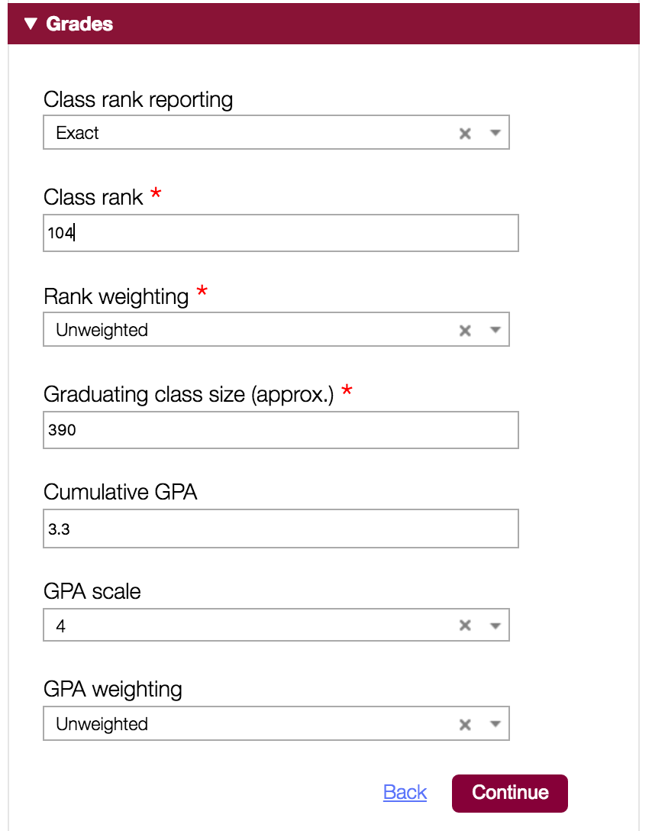
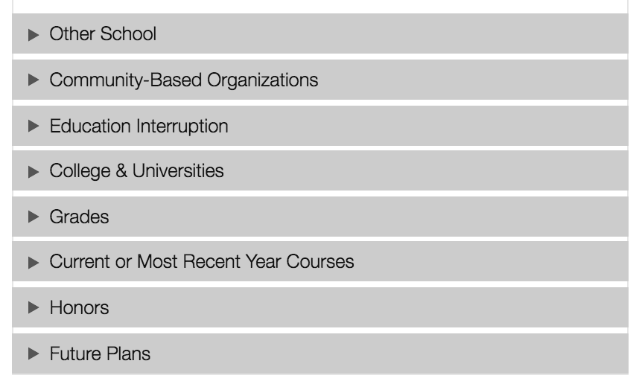
Education
Grades:
Class Rank: Exact
Rank Weighting: Unweighted
Class Size: 325
Cumulative GPA: Use Academic GPA 9-12 from transcript
GPA Scale: 4
GPA weighting: unweighted

Slide 17
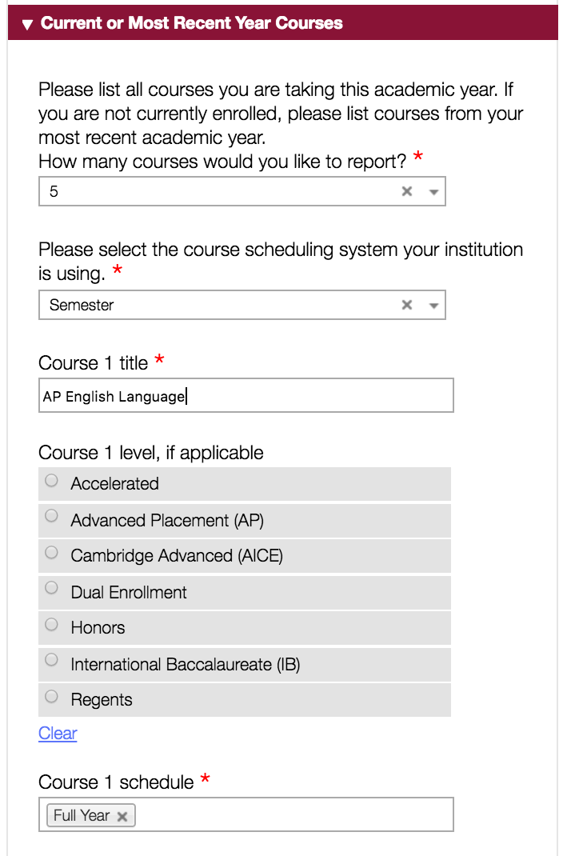
Education
Enter current 12th grade courses.
Each semester counts as one course unless the title is the same both semesters. Ex: Gov and Econ, Psychology
Don't put "Credit Recovery," put the name of the course you are taking.

Slide 18
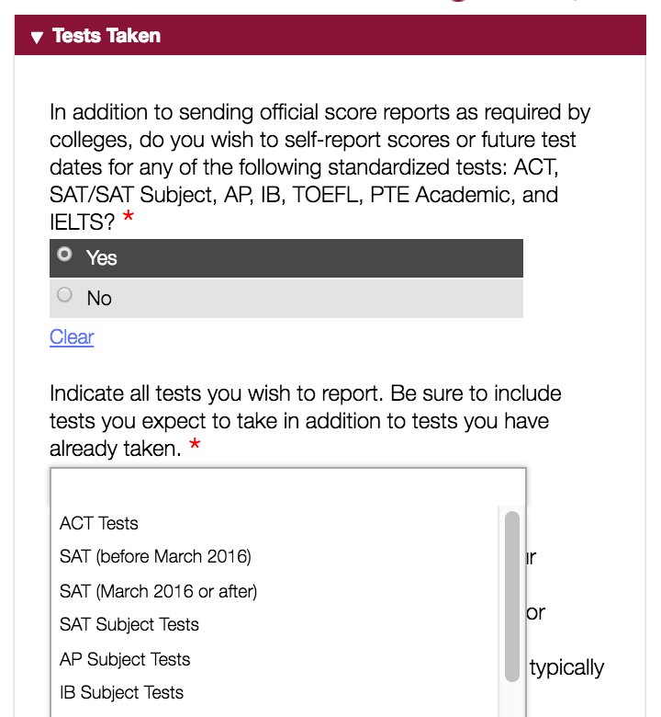
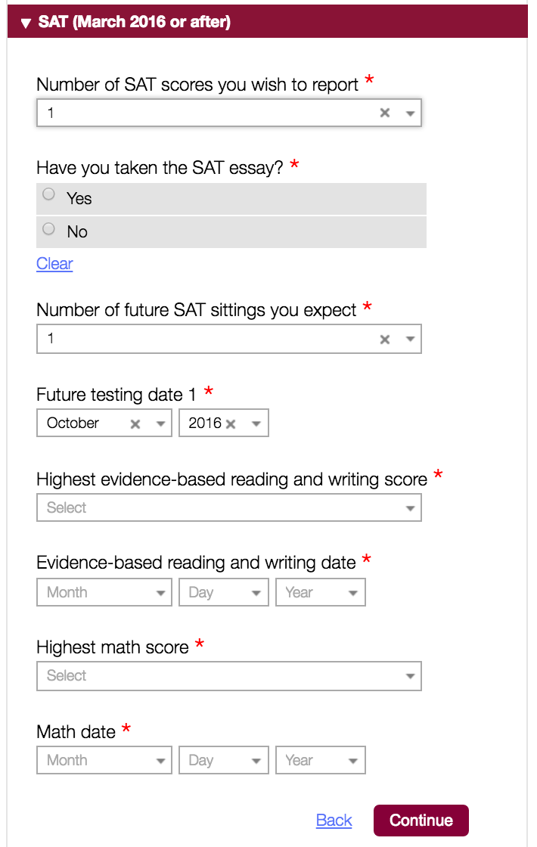
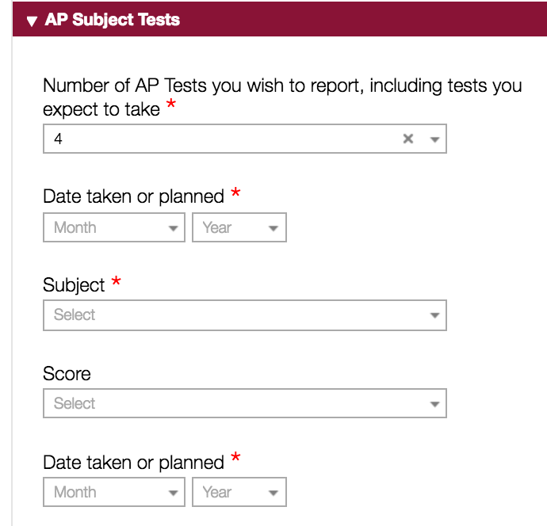
Education/Tests
Select all tests you have taken and want to report. Be sure to include future tests.

Slide 19
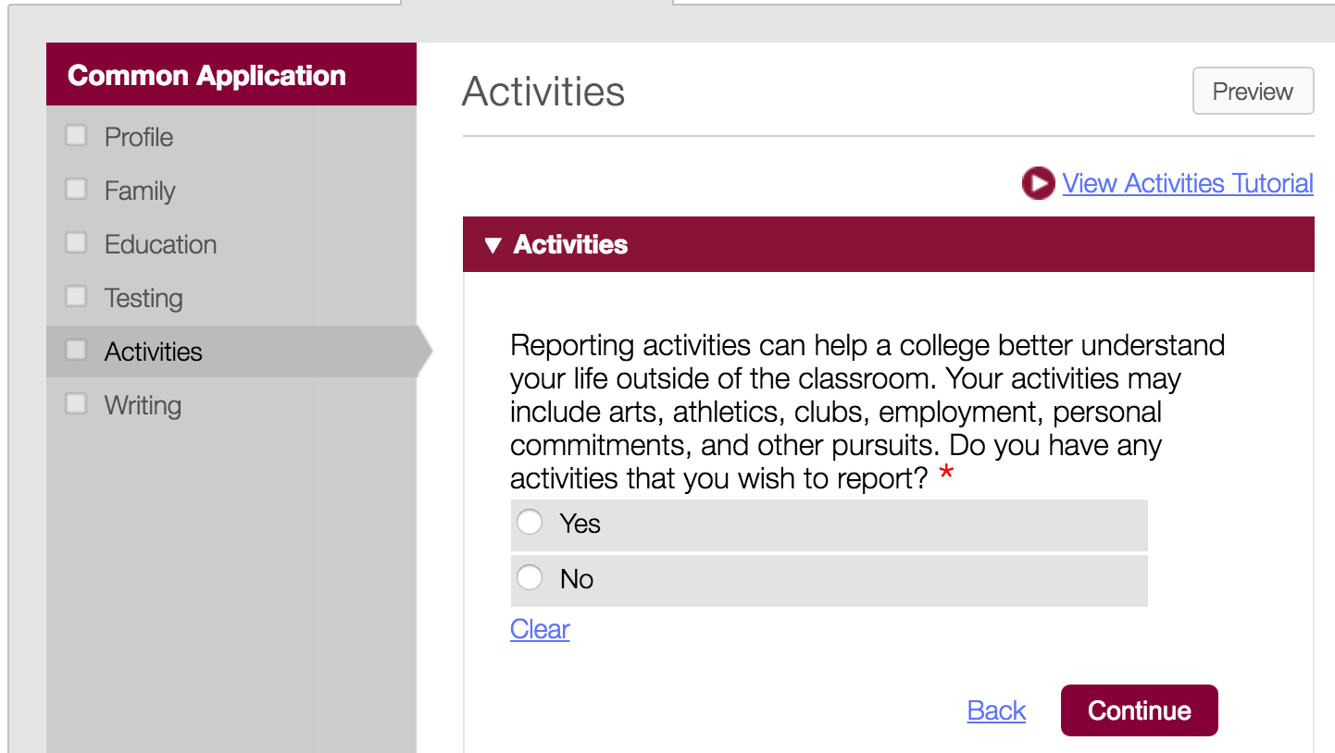
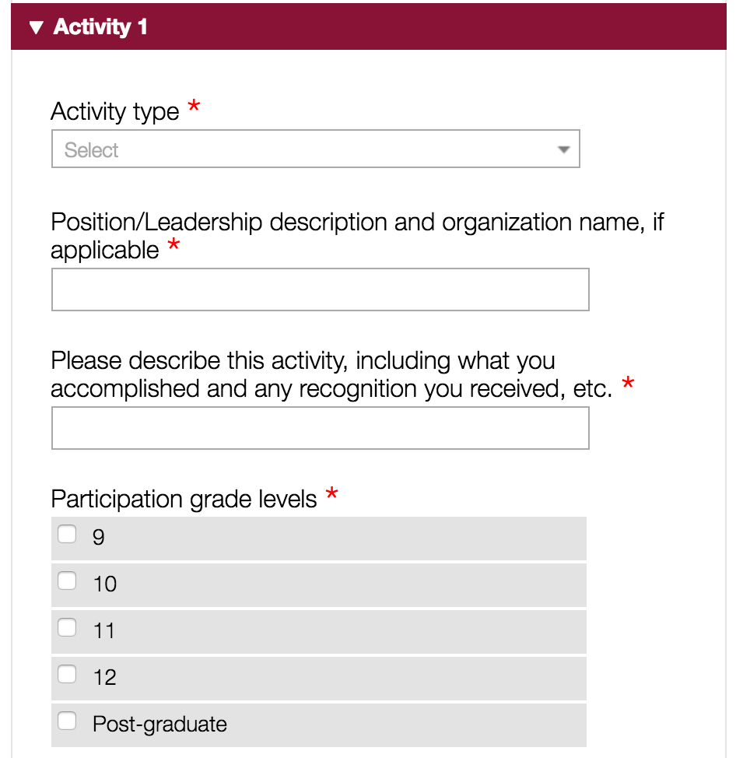
Activities
Be sure to include all relevant activities that you have participated in while in high school.

Slide 20
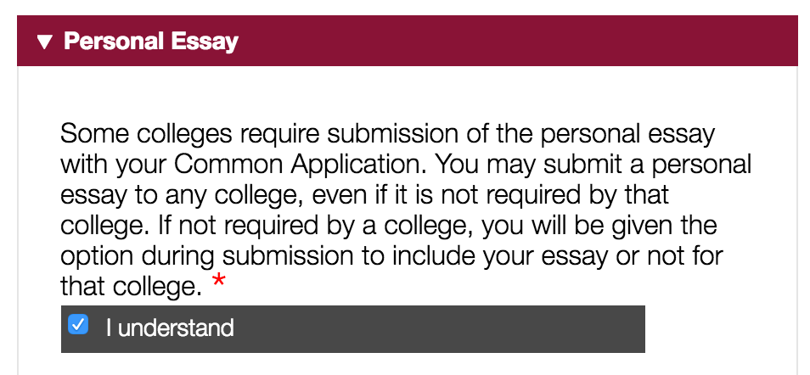
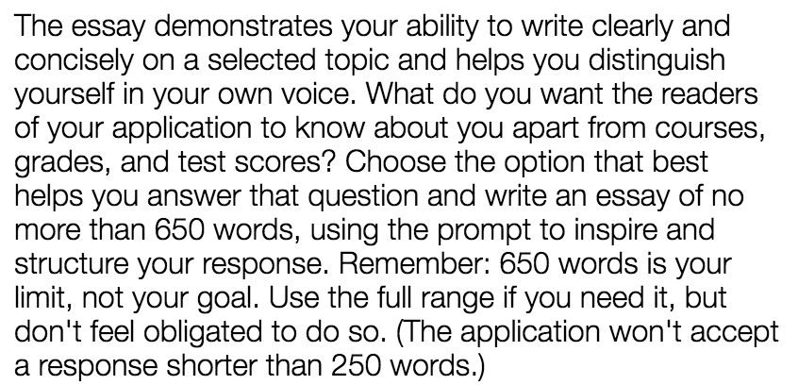
Personal Essay

Slide 21
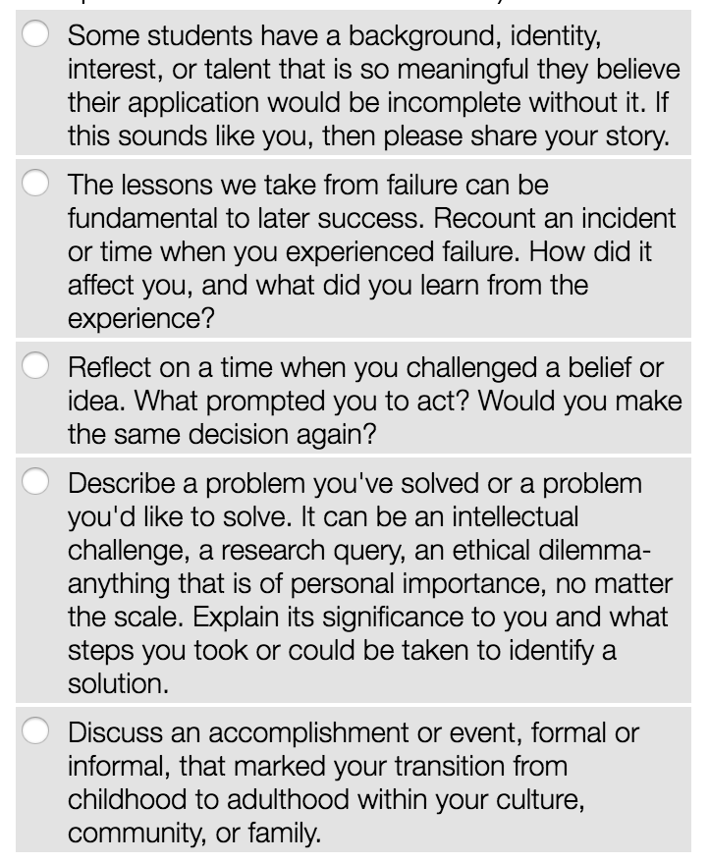
Personal Essay
Choose a personal essay prompt.
Essay must be 250-650 words.
Individual colleges may ask for additional writing responses for admission.

Slide 22
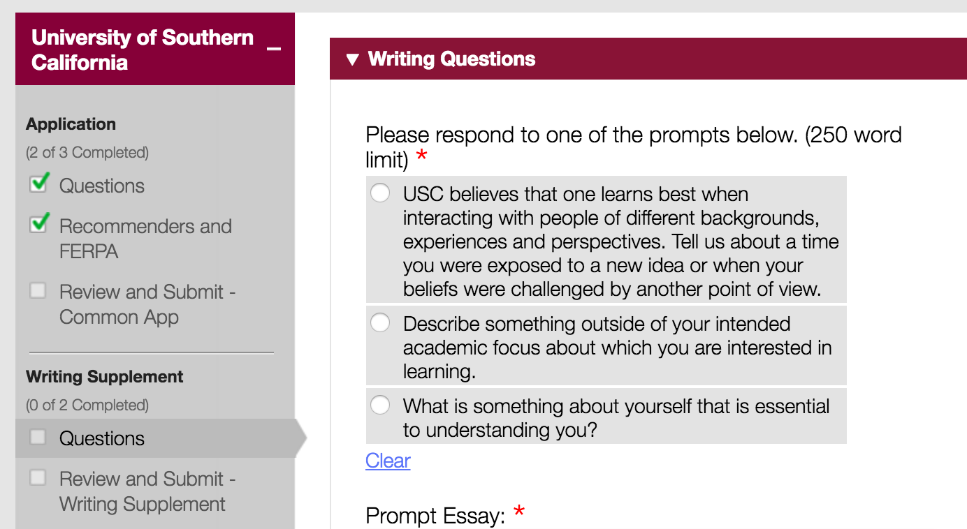
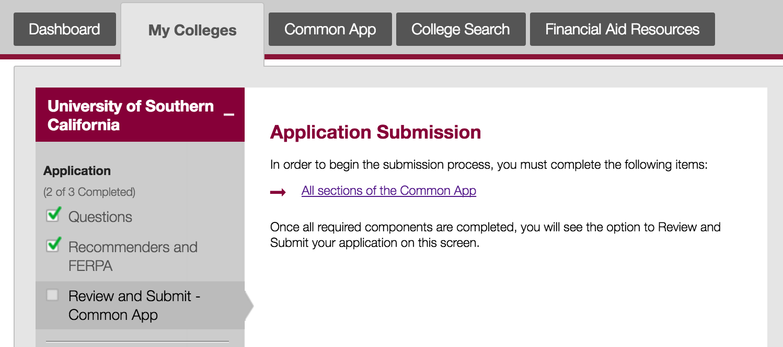
Review and Finalize
If a writing supplement is required, make sure you do that before submitting your application.

Slide 23
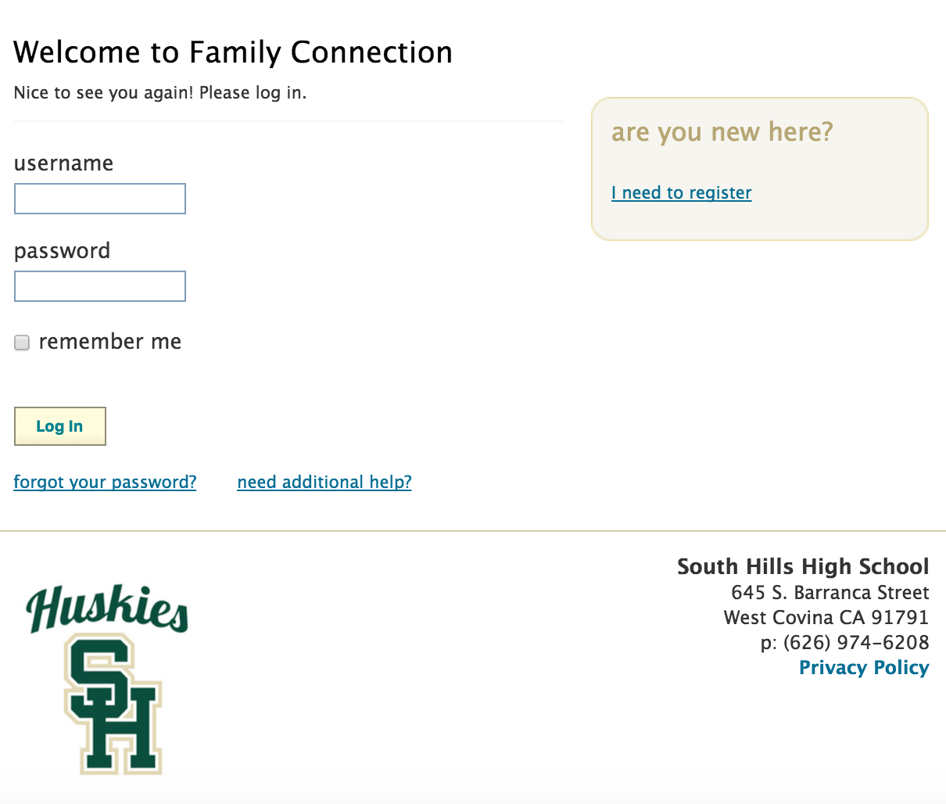
Naviance
Click here to log into Naviance
You will use Naviance to link your Common App account, list the colleges you are applying to, and to request letters of recommendation.
Username: Student ID #
Password: naviance

Slide 24
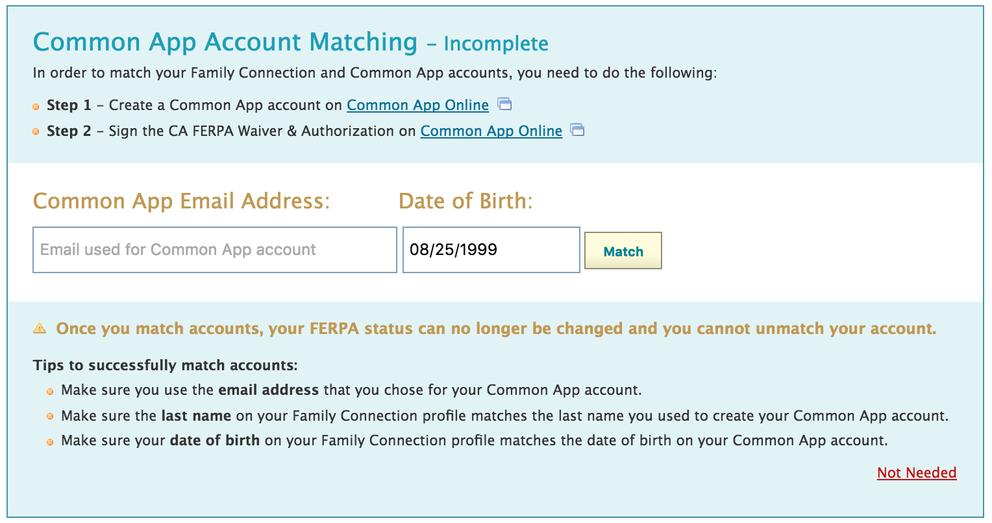
Naviance
Link your account
Click here to watch a video on how to link your accounts!
Students applying for college through Common App must link their Common App account to their Naviance account.
Go to the colleges tab
Click "Colleges I am applying to"
Complete the account matching
Follow these steps and then enter your email address here.

Slide 25
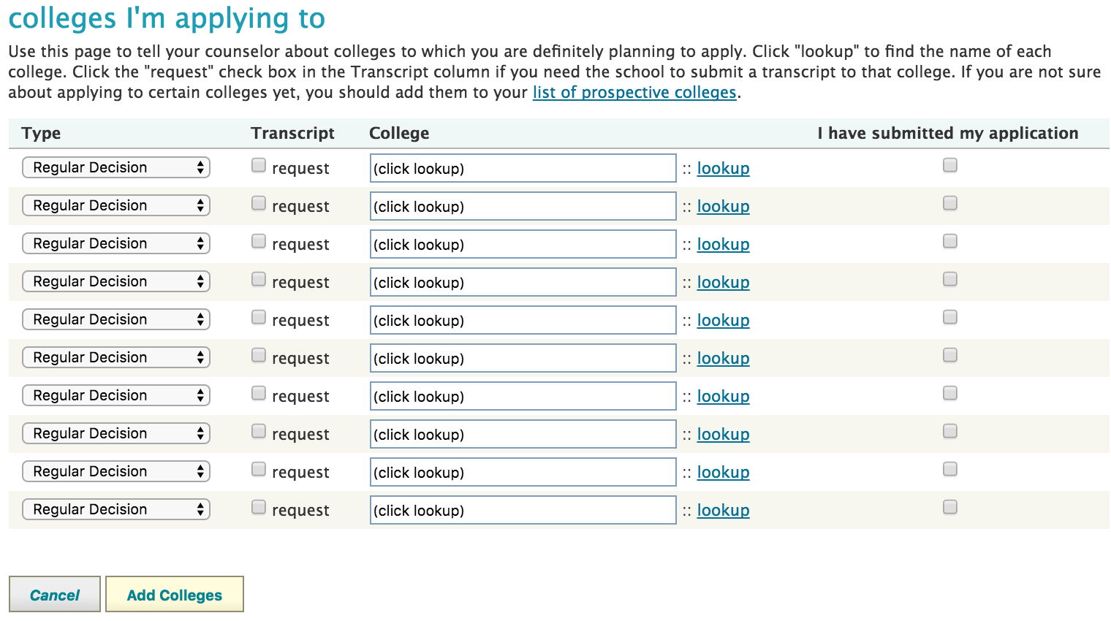
Naviance
Add colleges to your account
Add colleges to this list
Enter:
~Type of decision
~Click transcript request
~Lookup college
~Indicate if you have submitted your application
Colleges added in Common App will automatically appear here and you do not need to add them again.

Slide 26
Naviance Requesting a Letter of Recommendation
Step One:
Complete the “Senior Brag Sheet” available in the Counseling Office
Return completed “Senior Brag Sheet” to Mrs. Pieper (counseling secretary)
Step Two:
Go to the” colleges” tab
Click on “letters of recommendation”

Slide 27
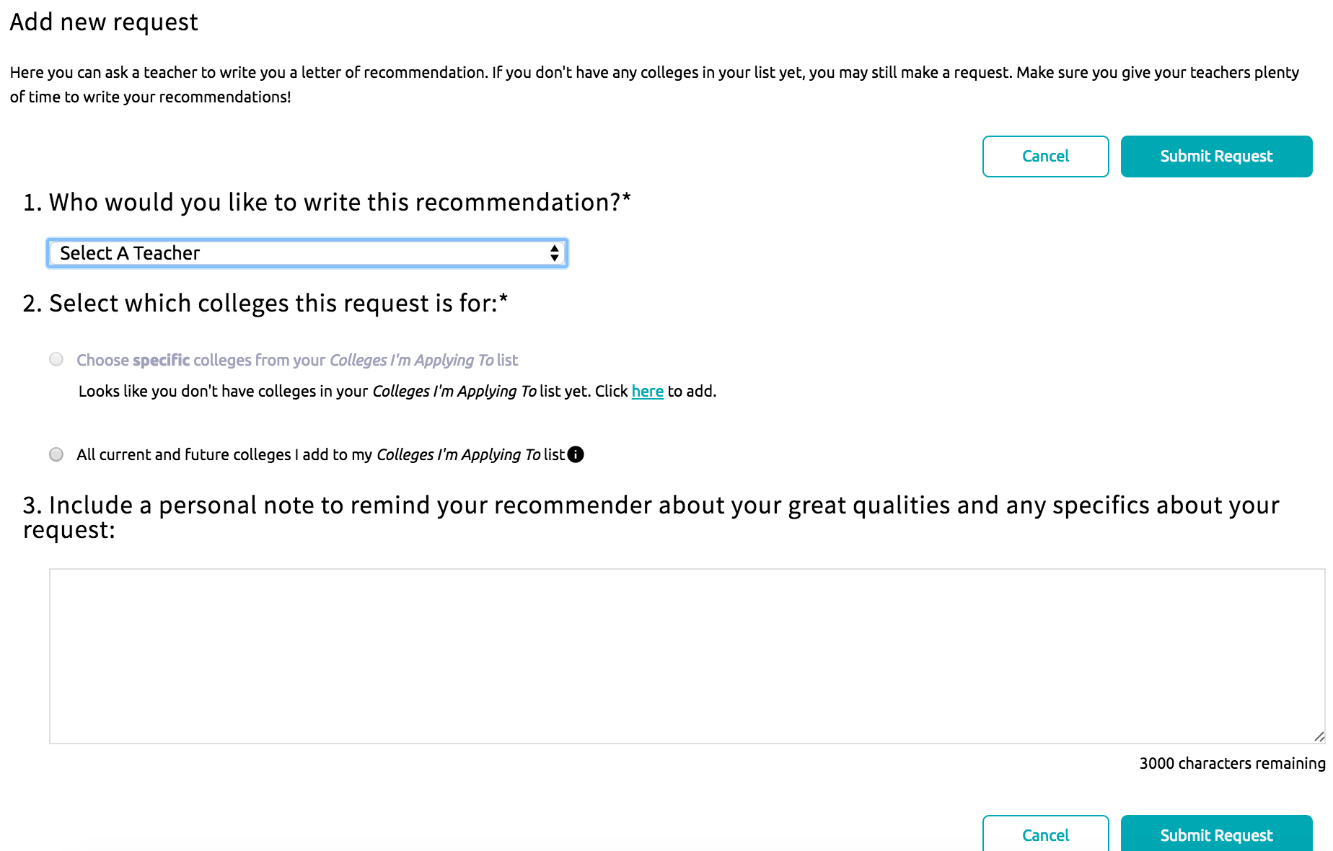
Naviance Requesting a Letter of Recommendation
Click on “add request”
Select the teacher you would like to write the recommendation.
Choose the school or choose “all”
Include a personal note.
Click “submit request”

Slide 28
Naviance Requesting a Letter of Recommendation
Tips to remember:
1) Plan ahead: Ask for letters well ahead of the deadline! Rule of thumb is ask for the letter TWO weeks before it is due. 2) Ask nicely: Explain what you are applying for (and why), and ask whether s/he might be willing to write you a letter of support. 3) Provide the deadline for the letter and follow up with the person writing the letter a few days before the deadline
4) Make it easy: Always make the process of writing a letter of recommendation as easy as possible.
5) Say ‘Thank you’ – It is classy and professional to say thanks to whoever writes letters of recommendation for you.

